Slide 1
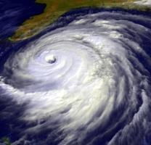
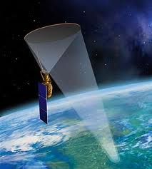
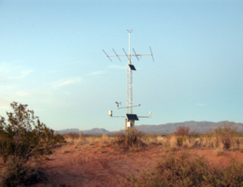


Impact of prolonged soil moisture deficit on grassland biomass production
John Hottenstein
Mentors: Susan Moran, USDA – Agricultural Research Service
Guillermo Ponce-Campos, University of Arizona
Main author: Morgan Ross, USDA – Agricultural Research Service
Arizona Space Grant Symposium, Tucson, AZ
April 12, 2014

Slide 2

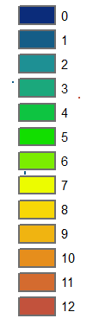
Soil Moisture
Soil moisture is used to predict plant response
Long duration soil moisture deficit causes widespread mortality

Slide 3
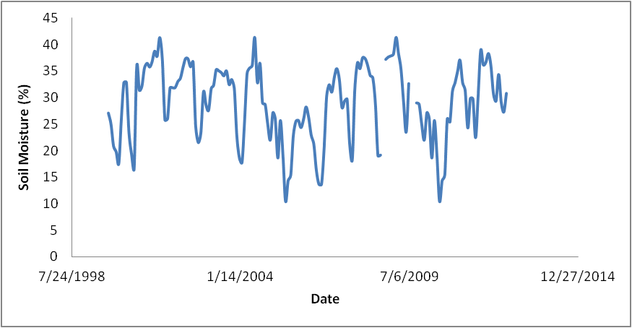
Prolonged Soil Moisture Deficit
Soil moisture deficit (Θ_{def})
  when the mean monthly soil moisture is below the mean monthly deficit soil moisture value
Prolonged soil moisture deficit (Pθ_{def})
  occurred when soil moisture deficit continued for greater than 10 months
Drought Identified
Mean monthly soil moisture value
If greater than 10 months then classified as a Pθ_{def}

Slide 4
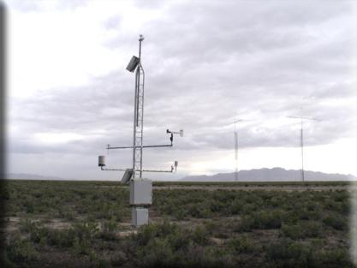

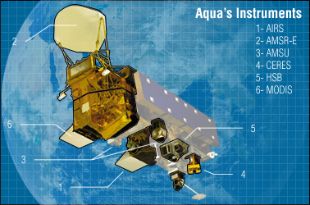

Data Networks
In situ
  Soil Climate Analysis Network (SCAN) data
Remote Sensing
  Soil Moisture and Ocean Salinity (SMOS) satellite
  MODIS Enhanced Vegetation Index (EVI)

Slide 5
Objective
Determine how a prolonged soil moisture deficit affected site soil moisture use efficiency.

Slide 6
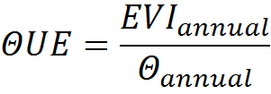
Soil moisture use efficiency (ΘUE)

Slide 7
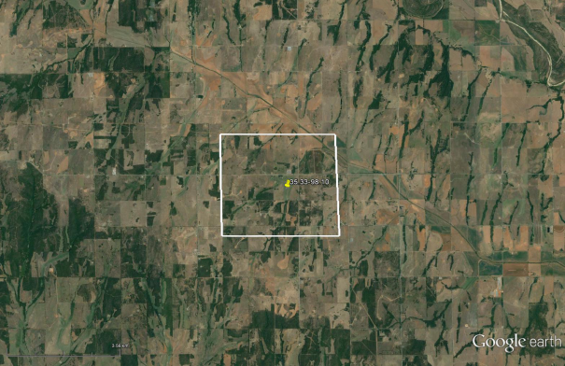
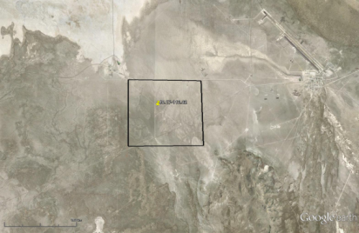
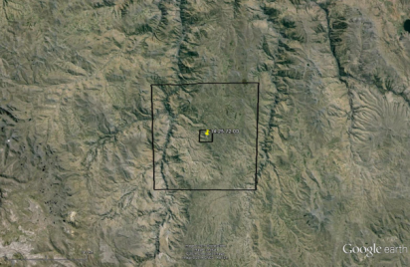
Grasslands
Mesic Grasslands
Arid Grasslands
Light limited (LL)
Annual Precipitation ≥ 500 mm
Water limited (WL)
Annual precipitation < 500 mm
3 of the 10 sites will be highlighted:
Fort Reno, OK
SCAN Network
Mesic grassland
Dugway, UT
SCAN Network
Arid grassland
Cusco region, Peru
Remote sensing
Arid grassland

Slide 8
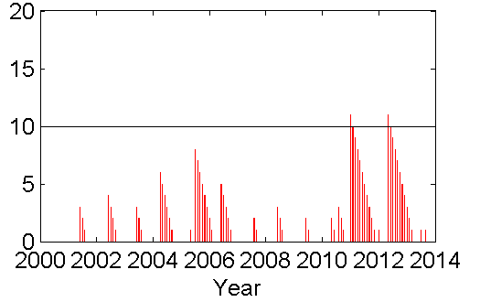
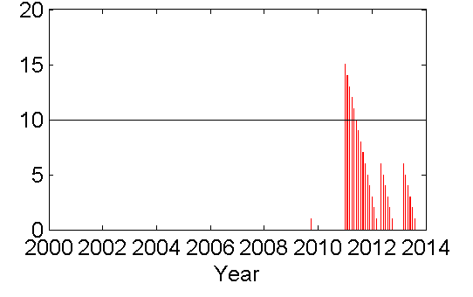
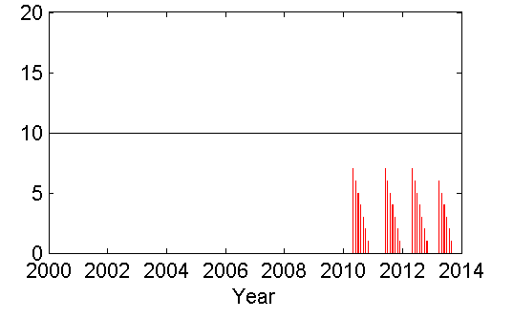
Soil Moisture Deficit
Fort Reno, OK (LL)
  Prolonged soil moisture deficit occurred in 2010 and 2012
Dugway, UT (WL)
  Prolonged soil moisture deficit occurred in 2011
Cusco region, Peru (WL)
  No prolonged soil moisture deficit occurred during study period
FR
DG
PE

Slide 9
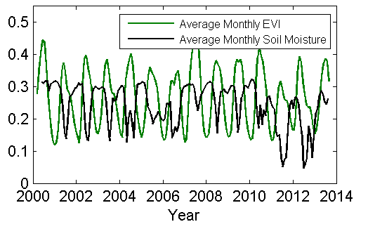
EVI and Soil Moisture
Fort Reno, OK (LL)
  EVI becomes more correlated with precipitation after prolonged soil moisture deficit

Slide 10
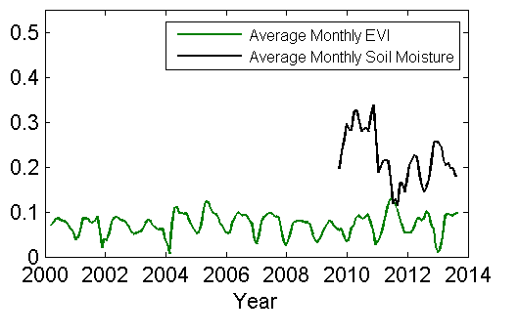
EVI and Soil Moisture
Dugway, UT (WL)
  Soil moisture values decrease but EVI values remain steady

Slide 11
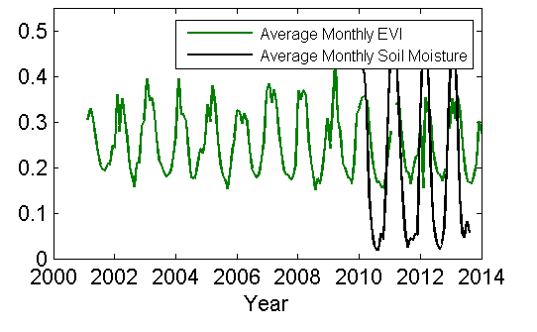
EVI and Soil Moisture
Cusco region, Peru (WL)
  Soil moisture and EVI are highly correlated

Slide 12
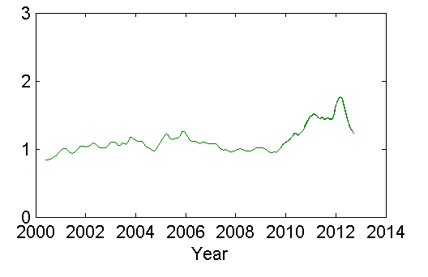
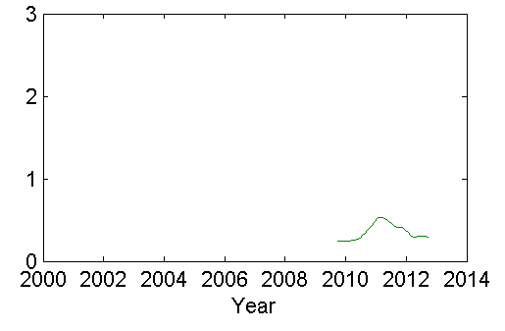
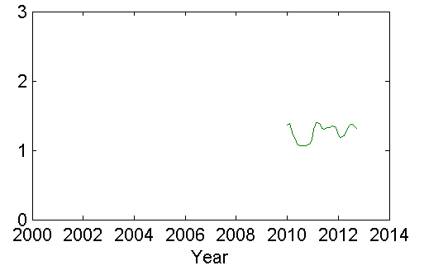
Soil Moisture Use Efficiency
Fort Reno, OK (LL)
  Sustained higher value of ΘUE after and during prolonged soil moisture deficit
Dugway, UT (WL)
  Single peak of ΘUE during prolonged soil moisture deficit occurrence
Cusco region, Peru (WL)
  ΘUE remains consistent
FR
DG
PE

Slide 13
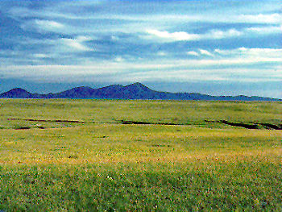
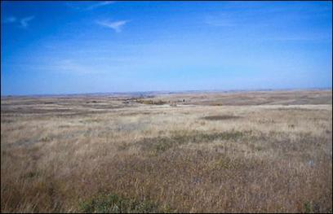
Conclusions
Prolonged soil moisture deficit resulted in changes of the ΘUE at both water- and light-limited sites
  At water-limited sites, ΘUE decreased to pre-deficit levels after the soil moisture deficit
  At light-limited sites, ΘUE remained high, sustaining throughout the soil moisture deficit
Vs.

Slide 14





Acknowledgements
Thank you to the Arizona NASA Space Grant Consortium, my mentors Susan Moran and Guillermo Ponce-Campos, and Morgan Ross for their help.

